Slide 1

Zephyr Workshop – Kconfig + DeviceTree
Understanding how Zephyr RTOS configures features and hardware

Slide 2
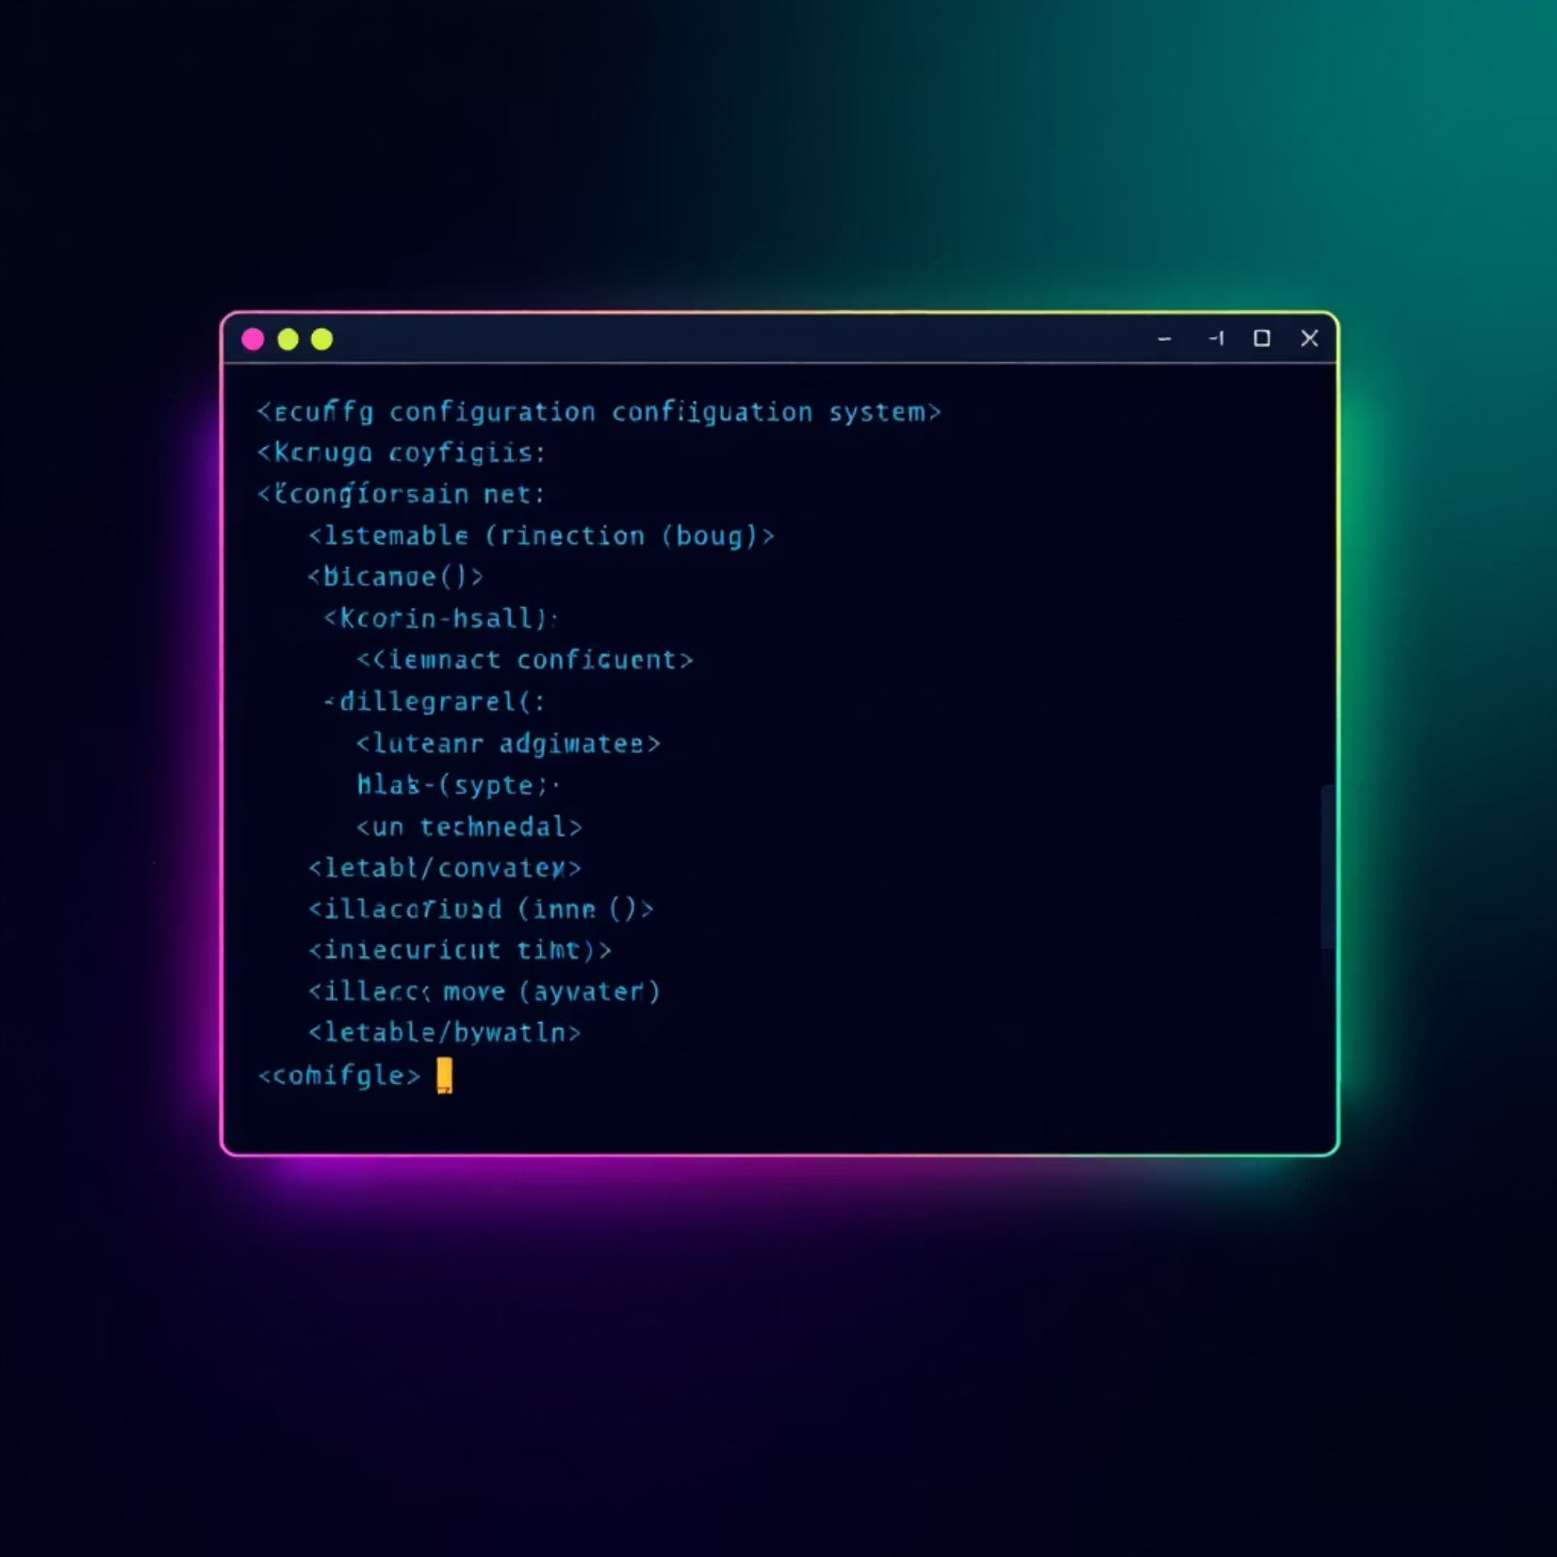
What is Kconfig?
Configuration system for:
System features
Drivers
RTOS options
Options start with 'CONFIG_'

Slide 3



Kconfig – How it Works
prj.conf
CMake + Kconfig
Header Files
CONFIG_PRINTK=y
Build system processing
Generated configuration
Use 'west build -t guiconfig' to explore

Slide 4

What is DeviceTree?
Hardware description language that:
Describes hardware layout and connections
Used by Zephyr at build time to generate hardware abstraction code.
Files: *.dts (base), *.overlay (app-level override)

Slide 5
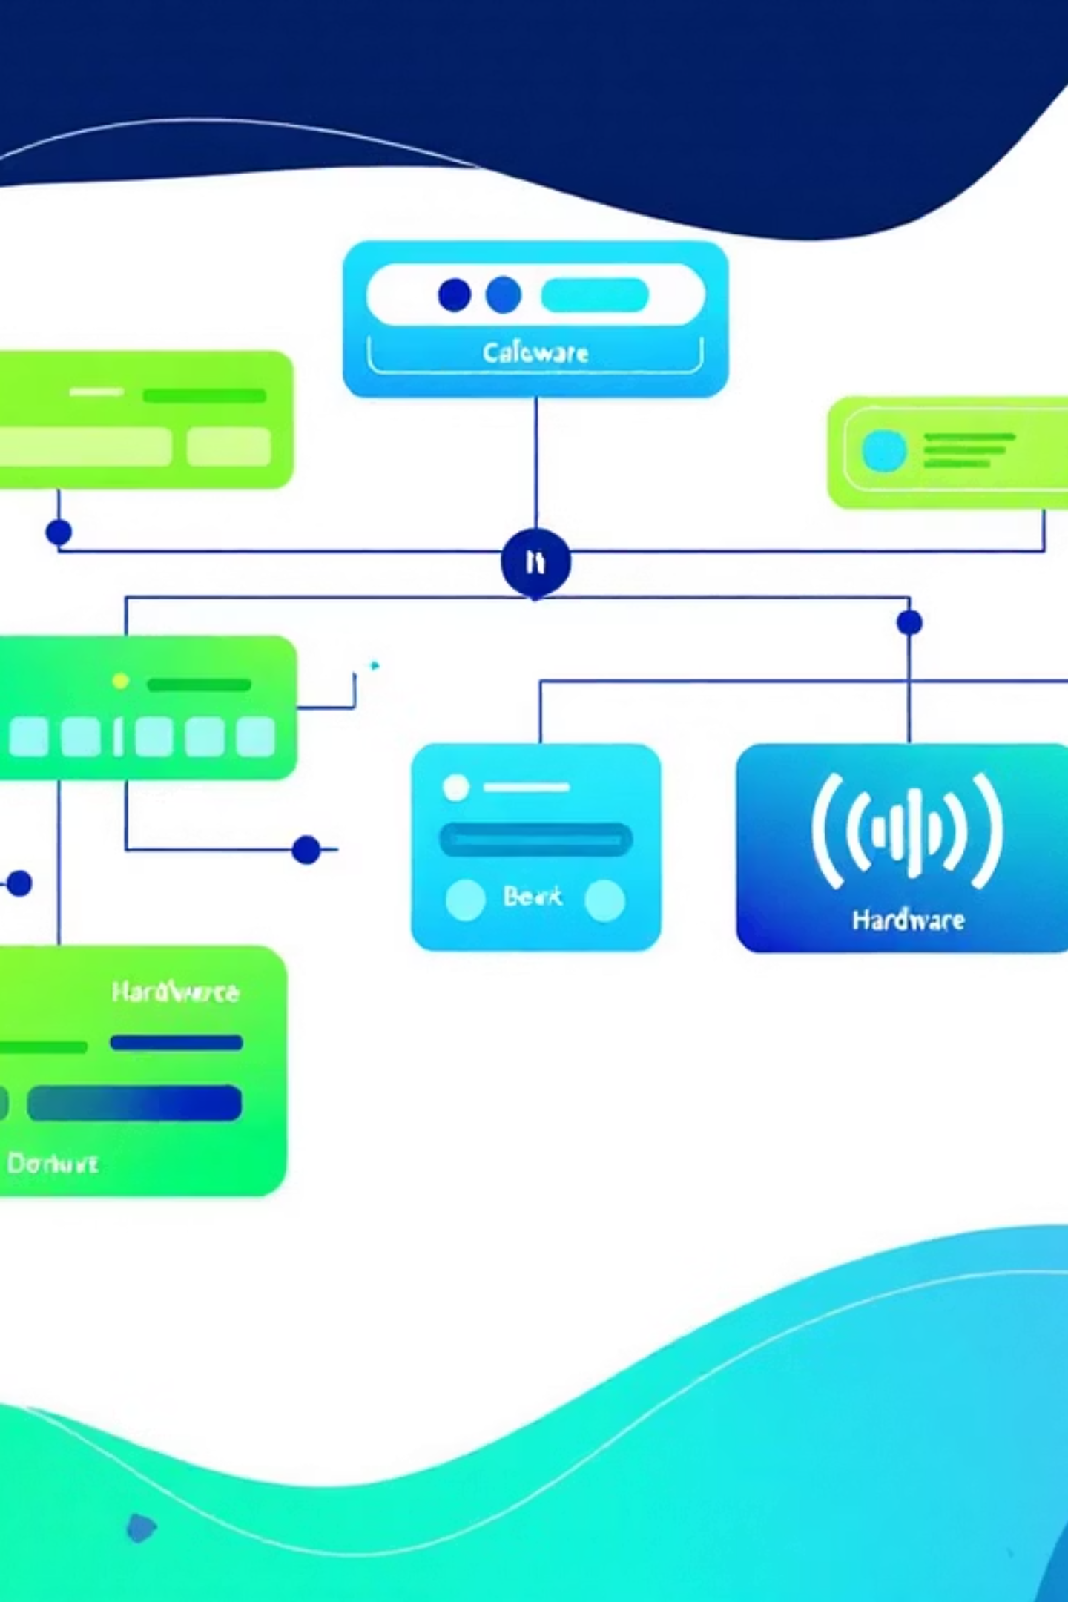
DeviceTree Concepts
Nodes
Properties
Hardware blocks (e.g., &gpio0)
Configuration data (pins, levels)
Labels & Aliases
Simplified code access

Slide 6






How Kconfig & DeviceTree Work Together
DeviceTree
Defines hardware (LED on GPIO0, pin 13)
Kconfig
Enables drivers (CONFIG_GPIO=y)
Application
Uses enabled, defined hardware

Slide 7

Live Example – LED Blink
Start with Hello World
Base project structure
Edit Files
prj.conf and main.c
Add app.overlay
Define LED alias

Slide 8
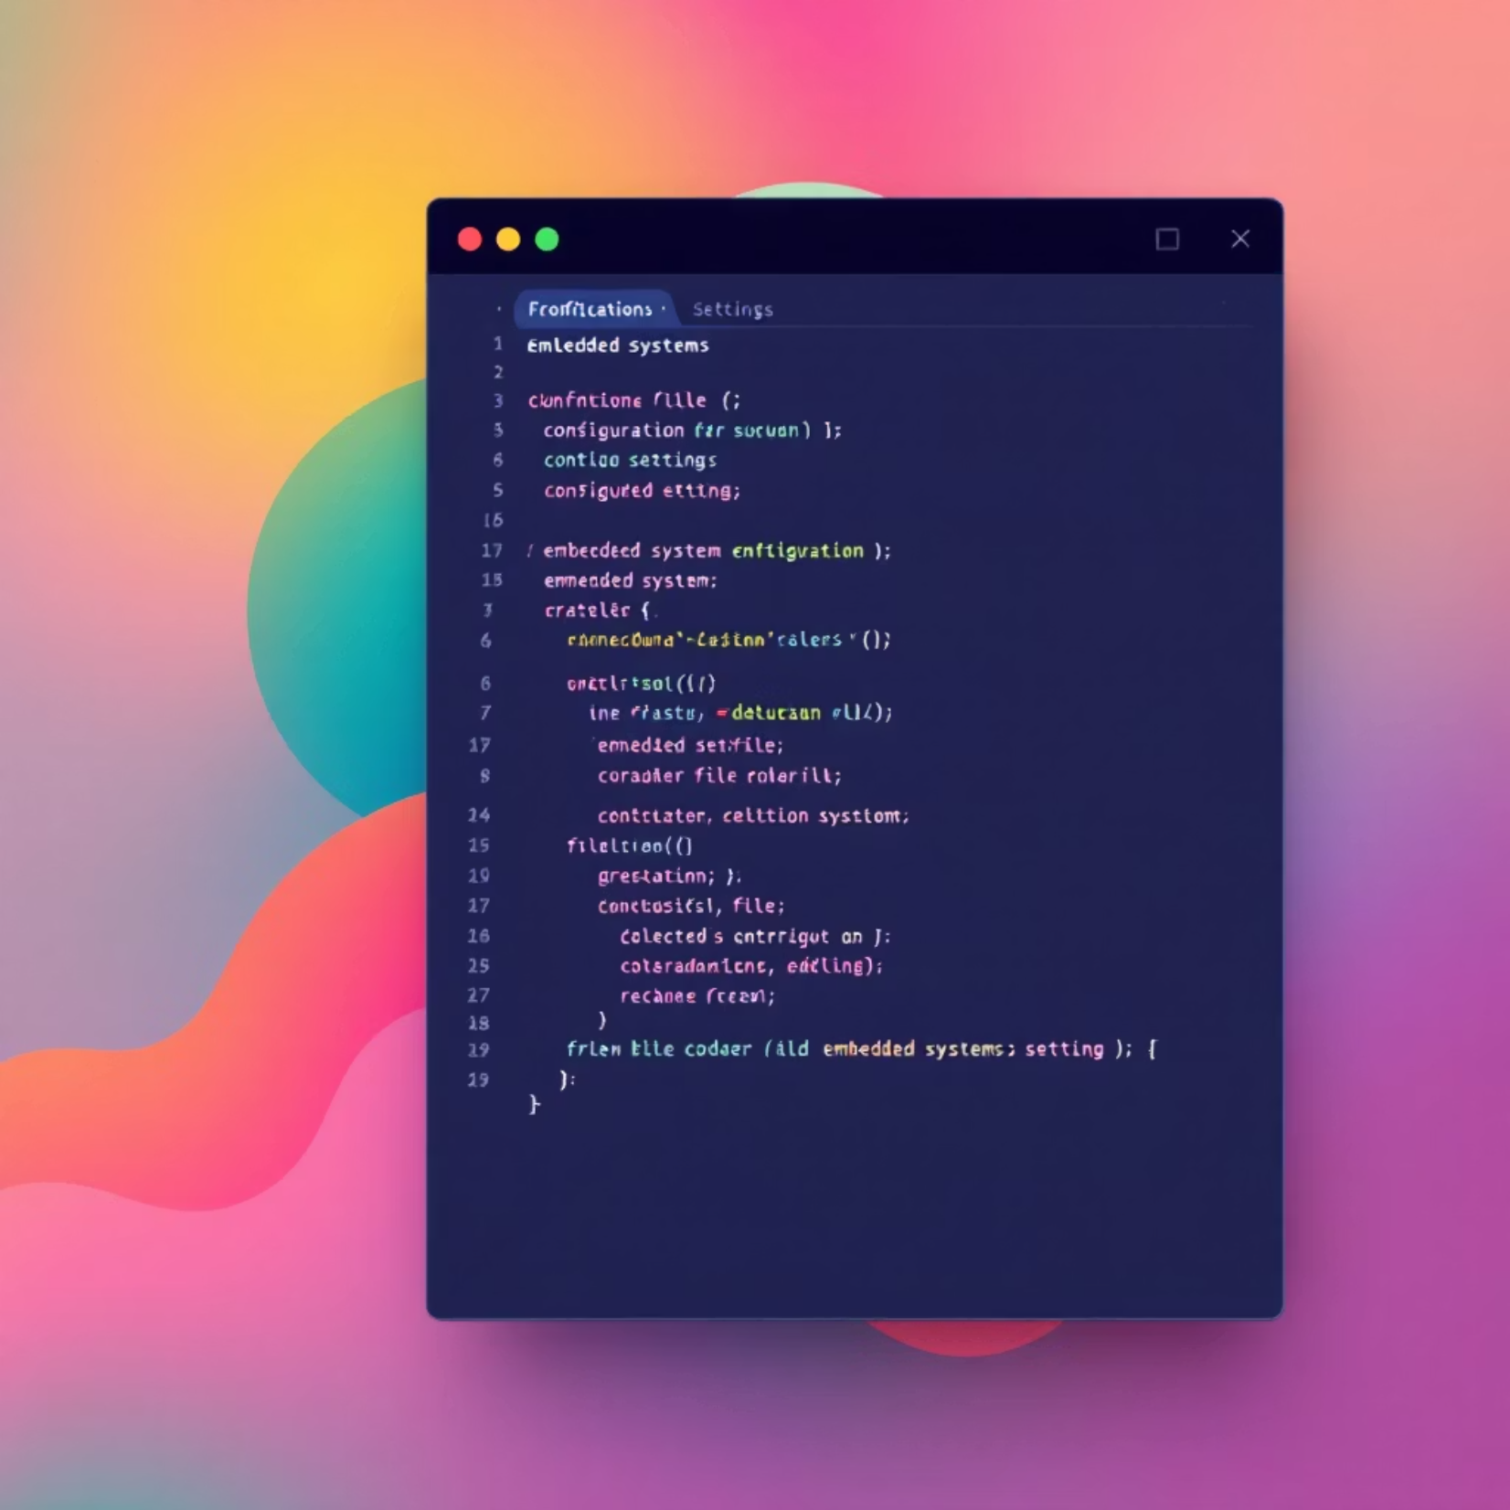
prj.conf – Example
CONFIG_GPIO=y
Enables the GPIO driver subsystem

Slide 9

app.overlay – Example
/ {
aliases {
led0 = &led0;
};
};
Defines hardware reference for LED

Slide 10

main.c – DeviceTree Usage
Add the code from blinky led sample to main.c

Slide 11

Run the sample
build and flash on nrf52dk
files .dts and _defconfig from the folder boards/nrf52dk generates the configuration
Check the file build/zephyr/.config
Check the file build/zephyr/zephyr.dts

Slide 12
Explore menuconfig
Run: west build -t guiconfig
Enable or disable options
Compare output with build/zephyr/.config now

